Slide 1

W4111 – 02: Introduction to Databases
Lecture 4: ER Modeling, SQL, Relational (Part 3)
Donald F. Ferguson dff9@Columbia.edu
TRANSCENDING DISCIPLINES, TRANSFORMING LIVES

Slide 2

We will start in a a couple of minutes.
2 | W4111_02_F20: Introduction to Databases -- Lecture 4

Slide 3
Questions
3 | W4111_02_F20: Introduction to Databases -- Lecture 4

Slide 4
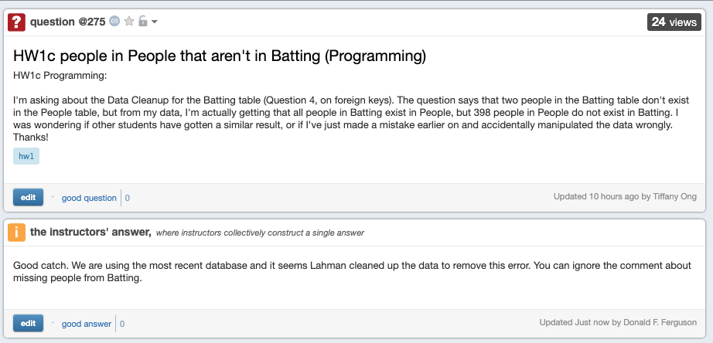
Piazza Data Cleanup Question
4 | W4111_02_F20: Introduction to Databases – Lecture 4

Slide 5
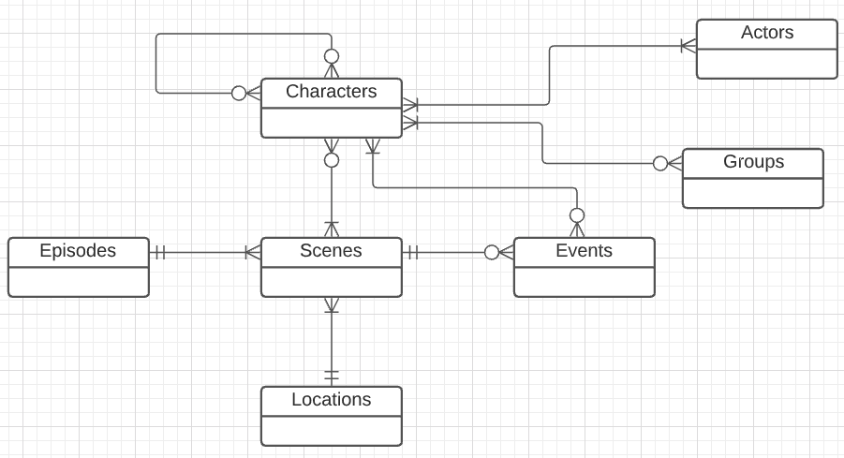
General Data Cleanup Questions and Issues
Finding interesting, large datasets to cleanup for assignments can be challenging.
Domain knowledge or documentation is necessary for cleanup, and the students in the class have diverse backgrounds.
I used Game of Thrones last year, but the series is dated and no longer cool, especially after the final season.
Characters CSV file with info about characters in GoT TV show.
Episodes Info about seasons and episodes, e.g. date, title.
Scenes An episode is a sequence of scenes with location, duration, etc.
Events Something happened to someone.
Locations Info about places.
Groups Things like families, organizations, ...
Actors Which real world actors played which characters.
5 | W4111_02_F20: Introduction to Databases – Lecture 4

Slide 6
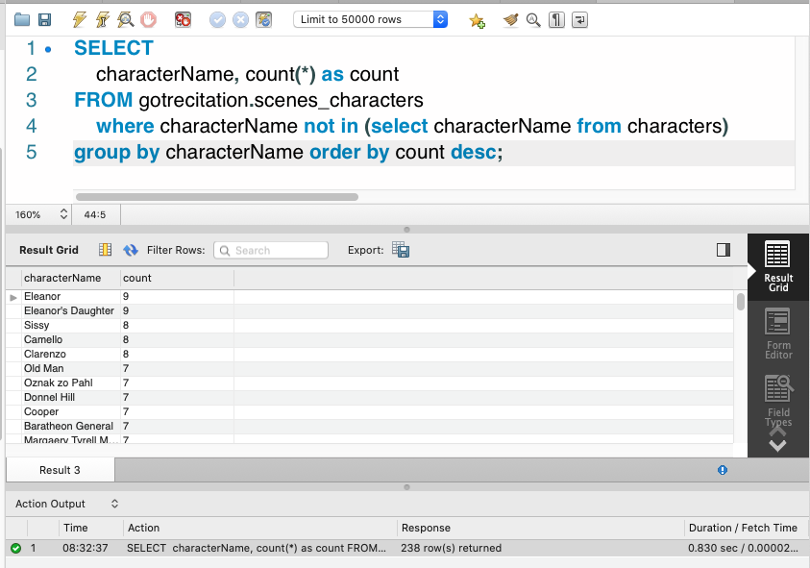
General Data Cleanup Questions and Issues
An apparently obvious constraint is: “If a character appeared in a scene, the character must exist in the character table.”
There are:
238 characters in scenes that are not in the characters table.
Some of the missing characters are in 9 scenes.
There are some other interesting issues.
6 | W4111_02_F20: Introduction to Databases – Lecture 4

Slide 7
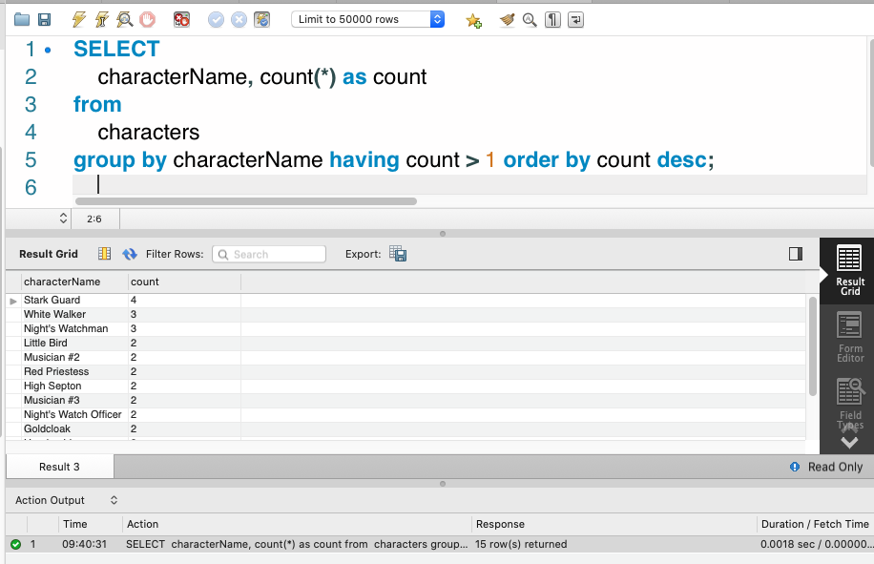
General Data Cleanup Questions and Issues
characterName is not unique in Characters.
There are:
15 duplicate characterNames
Some occur as many as 4 times.
Some lessons:
Names as not good choices for primary key.
Sometimes you do not know the value of something critical.
7 | W4111_02_F20: Introduction to Databases – Lecture 4

Slide 8
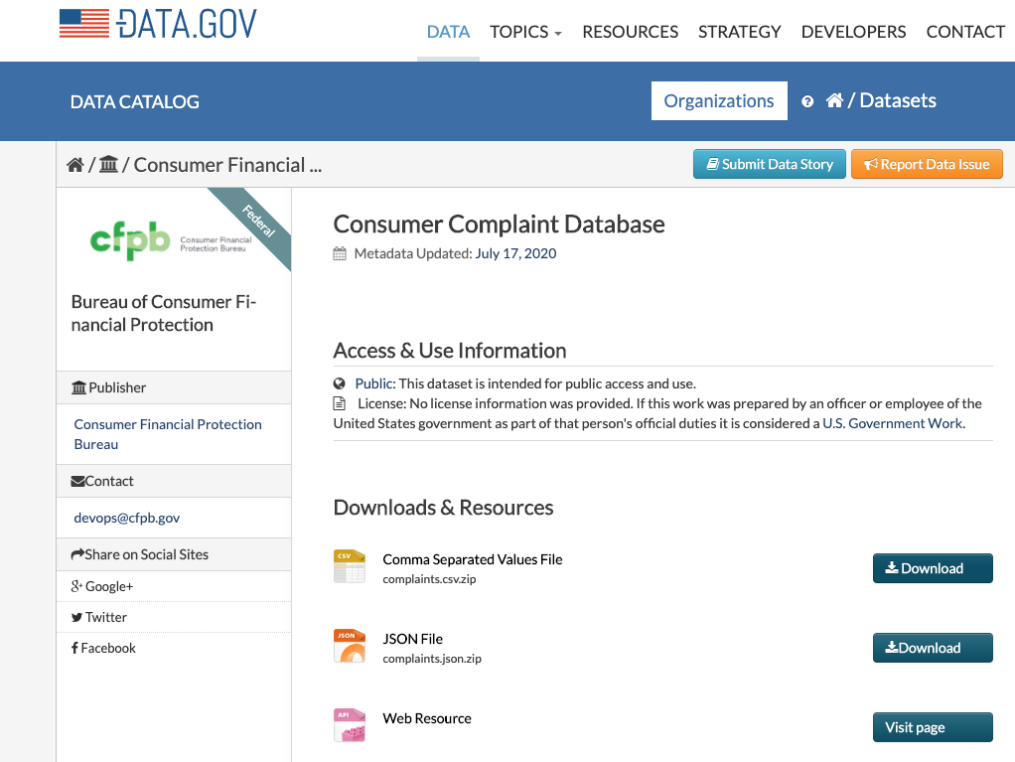
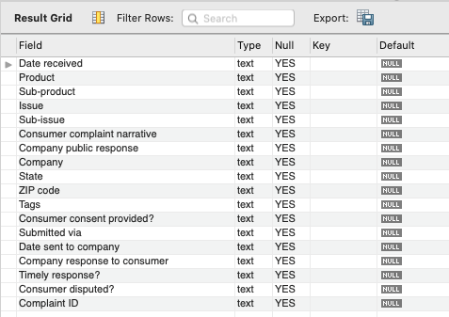
General Data Cleanup Questions and Issues
File of consumer complaints about financial institutions.
Size:
1.1 GB.
1.7 million rows.
18 columns.
Opening this file in Excel or Google Sheets is not fun.
I loaded into a MySQL table.
https://catalog.data.gov/dataset/consumer-complaint-database
8 | W4111_02_F20: Introduction to Databases – Lecture 4

Slide 9
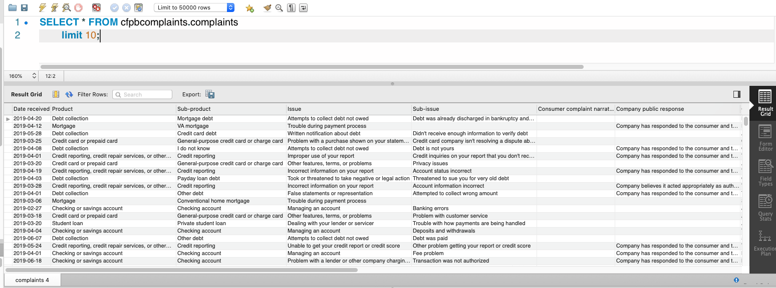
General Data Cleanup Questions and Issues
This is what the data looks like.
You can play with the data using a web application https://www.consumerfinance.gov/data-research/consumer-complaints/
9 | W4111_02_F20: Introduction to Databases – Lecture 4

Slide 10
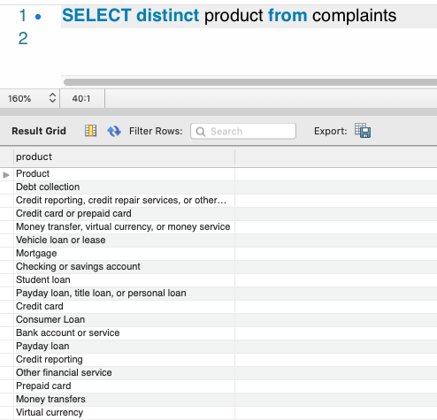
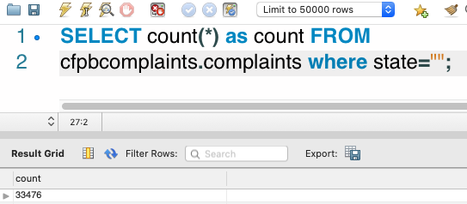
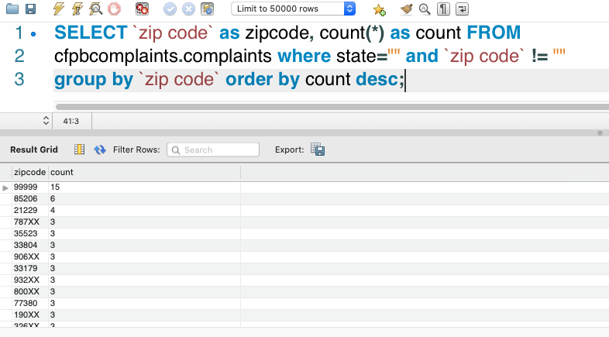
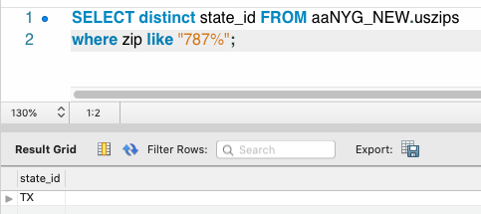
General Data Cleanup Questions and Issues
There are 33K where we do not know the state.
There are 1.7 million rows but only 19 distinct values for “Product.”
Even if we only know the first 3 digits in the zip, we still know the state.
There are a lot of complaints where I do not know the state but do know the zip code, which means I may know the state.
10 | W4111_02_F20: Introduction to Databases – Lecture 4

Slide 11
Data Cleanup Comments
There are a lot of reasons data can be “icky.”
Human data entry errors.
The data is from old records and may be incomplete.
There is a mismatch between the data entry representation and a good data model.
If you look at the 18 columns in Complaints.
There are actually several entity types, e.g. Complaint, Company.
Files are text but the data columns are typed, e.g. enum, number, ... ...
You are merging data from multiple sources and they represent common concepts different or inconsistently.
Relational model:
A lot of the capabilities in the relational model exists to prevent insert or update of “bad data.”
The relational model uses types and keys to link thinks, which is critical for analysis, reporting, data insight, etc.
11 | W4111_02_F20: Introduction to Databases – Lecture 4

Slide 12
Lecture/Teaching Style
12 | W4111_02_F20: Introduction to Databases -- Lecture 4

Slide 13
Lecture/Teaching Style
I am continuously refining and evolving my approach to lectures, recitations and office hours.
The style, ordering, mix of slides to hands-on, etc. Changes
From semester to semester.
Within a semester.
I am trying to avoid “simple reading and explaining the slides.”
You can learn much of the information by reading the book, online tutorials, etc.
My lecturing following the slides bores me to death and must do the same to you.
My main value is helping you understand how to apply and understand more deeply.
This lecture and the last are “a lot of slides.”
I am trying to get to worked examples but keep running out of time.
I will try to manage time better to make sure we get to the stuff you cannot just get from tutorials and slides.
13 | W4111_02_F20: Introduction to Databases – Lecture 4

Slide 14
Relational Model Continued
14 | W4111_02_F20: Introduction to Databases -- Lecture 4
Notes:
bb

Slide 15
Relational Algebra
A procedural language consisting of a set of operations that take one or two relations as input and produce a new relation as their result.
Six basic operators
select: σ
project: ∏
union: ∪
set difference: –
Cartesian product: x
rename: ρ
Customers(id, lastname, firstname, iq)

Slide 16
Composition of Relational Operations
The result of a relational-algebra operation is relation and therefore of relational-algebra operations can be composed together into a relational-algebra expression.
Consider the query -- Find the names of all instructors in the Physics department.
∏_{name}(σ _{dept_name} _{=“Physics”} (instructor))
Instead of giving the name of a relation as the argument of the projection operation, we give an expression that evaluates to a relation.
Relational is an algebra and closed under the operators.
This is a very, very powerful concept, which we will see in future lectures.

Slide 17
Cartesian-Product Operation
The Cartesian-product operation (denoted by X) allows us to combine information from any two relations.
Example: the Cartesian product of the relations instructor and teaches is written as:
instructor X teaches
We construct a tuple of the result out of each possible pair of tuples: one from the instructor relation and one from the teaches relation (see next slide)
Since the instructor ID appears in both relations we distinguish between these attribute by attaching to the attribute the name of the relation from which the attribute originally came.
instructor.ID
teaches.ID

Slide 18
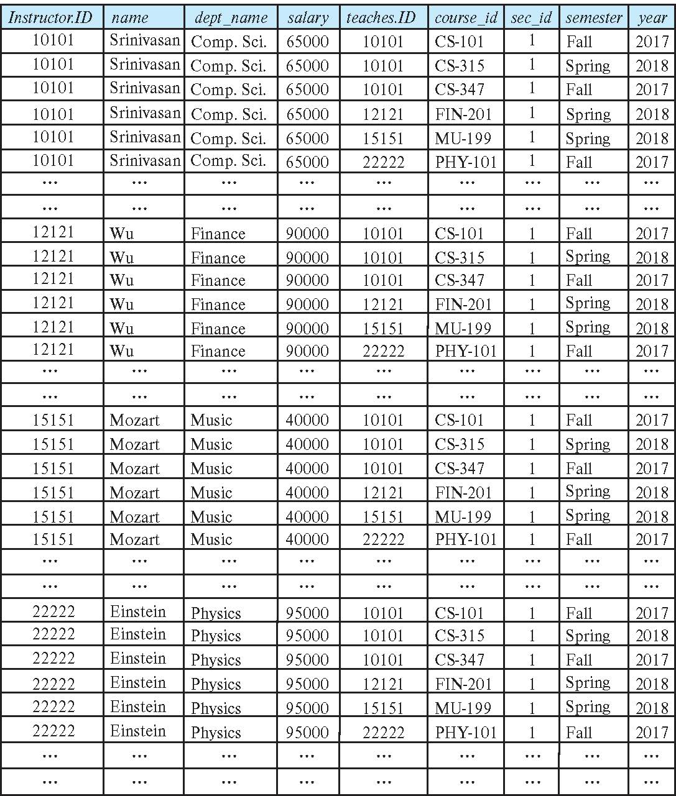
The instructor X teaches table

Slide 19
Join Operation
The Cartesian-Product
instructor X teaches
associates every tuple of instructor with every tuple of teaches.
Most of the resulting rows have information about instructors who did NOT teach a particular course.
To get only those tuples of “instructor X teaches “ that pertain to instructors and the courses that they taught, we write:
σ _{instructor.id = teaches.id} (instructor x teaches ))
We get only those tuples of “instructor X teaches” that pertain to instructors and the courses that they taught.
The result of this expression, shown in the next slide

Slide 20
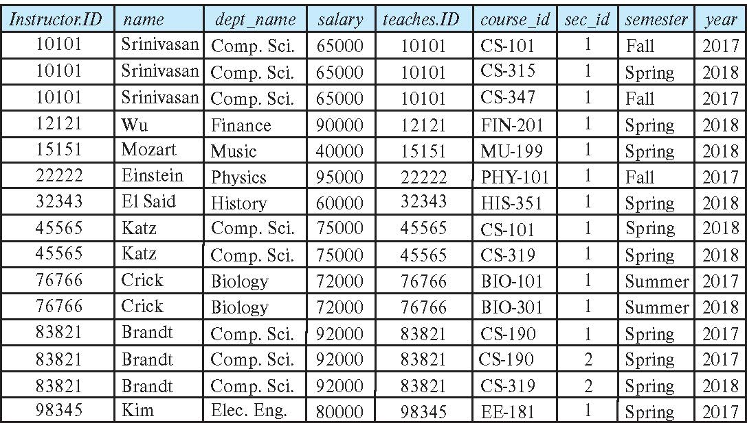
Join Operation (Cont.)
The table corresponding to:
σ _{instructor.id = teaches.id} (instructor x teaches))

Slide 21
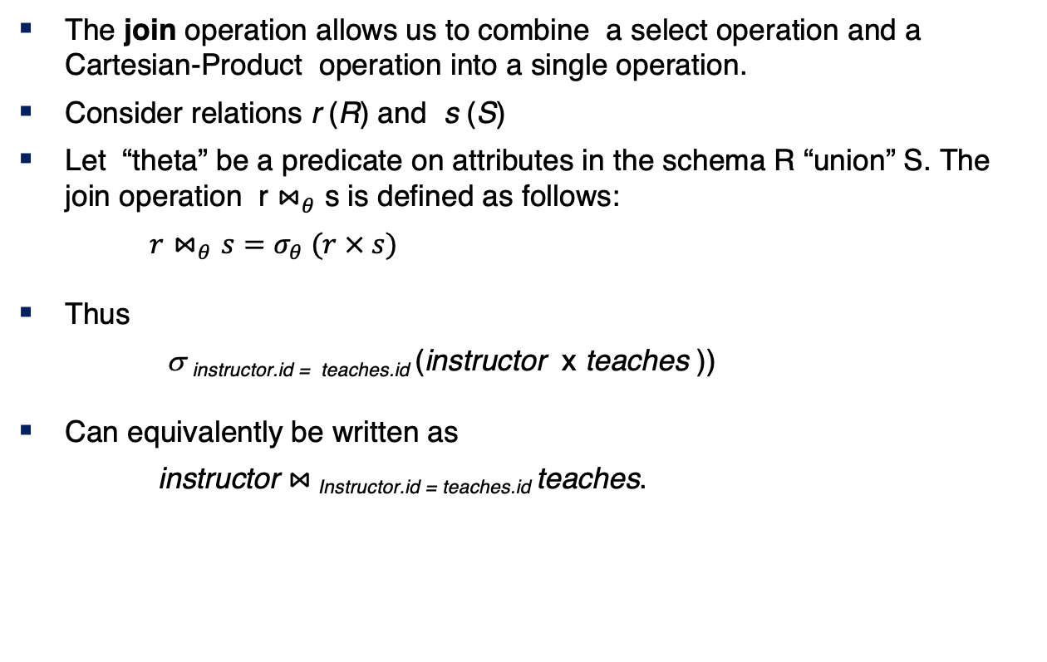
Join Operation (Cont.)
The join operation allows us to combine a select operation and a Cartesian-Product operation into a single operation.
Consider relations r (R) and s (S)
Let “theta” be a predicate on attributes in the schema R “union” S. The join operation r $⋈_{θ}$ s is defined as follows:
$r⋈_{θ}s=σ_{θ} (r × s)$
Thus
σ _{instructor.id = teaches.id} (instructor x teaches ))
Can equivalently be written as
instructor $⋈_{ }$_{Instructor.id = teaches.id} teaches.

Slide 22
Union Operation
The union operation allows us to combine two relations
Notation: r ∪ s
For r ∪ s to be valid.
1. r, s must have the same arity (same number of attributes)
2. The attribute domains must be compatible (example: 2nd
column of r deals with the same type of values as does the 2nd column of s)
Example: to find all courses taught in the Fall 2017 semester, or in the Spring 2018 semester, or in both ∏_{course_id} (σ _{semester=“Fall” Λ year=2017} (section)) ∪ ∏_{course_id} (σ _{semester=“Spring” Λ year=2018} (section))

Slide 23
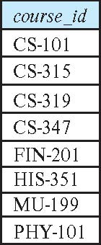
Union Operation (Cont.)
Result of: ∏_{course_id} (σ _{semester=“Fall” Λ year=2017} (section)) ∪ ∏_{course_id} (σ _{semester=“Spring” Λ year=2018} (section))

Slide 24
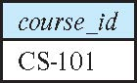
Set-Intersection Operation
The set-intersection operation allows us to find tuples that are in both the input relations.
Notation: r ∩ s
Assume:
r, s have the same arity
attributes of r and s are compatible
Example: Find the set of all courses taught in both the Fall 2017 and the Spring 2018 semesters.
∏_{course_id} (σ _{semester=“Fall” Λ year=2017} (section)) ∩ ∏_{course_id} (σ _{semester=“Spring” Λ year=2018} (section))
Result

Slide 25
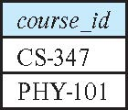
Set Difference Operation
The set-difference operation allows us to find tuples that are in one relation but are not in another.
Notation r – s
Set differences must be taken between compatible relations.
r and s must have the same arity
attribute domains of r and s must be compatible
Example: to find all courses taught in the Fall 2017 semester, but not in the Spring 2018 semester ∏_{course_id} (σ _{semester=“Fall” Λ year=2017} (section)) − ∏_{course_id} (σ _{semester=“Spring” Λ year=2018} (section))

Slide 26
The Assignment Operation
It is convenient at times to write a relational-algebra expression by assigning parts of it to temporary relation variables.
The assignment operation is denoted by ← and works like assignment in a programming language.
Example: Find all instructor in the “Physics” and Music department. Physics ← σ _{dept_name=“Physics”} (instructor)
Music ← σ _{dept_name=“Music”} (instructor)
Physics ∪ Music
With the assignment operation, a query can be written as a sequential program consisting of a series of assignments followed by an expression whose value is displayed as the result of the query.

Slide 27
The Rename Operation
The results of relational-algebra expressions do not have a name that we can use to refer to them. The rename operator, ρ , is provided for that purpose
The expression:
ρ_{x} (E)
returns the result of expression E under the name x
Another form of the rename operation:
ρ_{x(A1,A2, .. An)} (E)

Slide 28
Equivalent Queries
There is more than one way to write a query in relational algebra.
Example: Find information about courses taught by instructors in the Physics department with salary greater than 90,000
Query 1
σ _{dept_name=“Physics”} ∧ _{salary > 90,000} (instructor)
Query 2
σ _{dept_name=“Physics”} (σ _{salary > 90.000} (instructor))
The two queries are not identical; they are, however, equivalent -- they give the same result on any database.

Slide 29
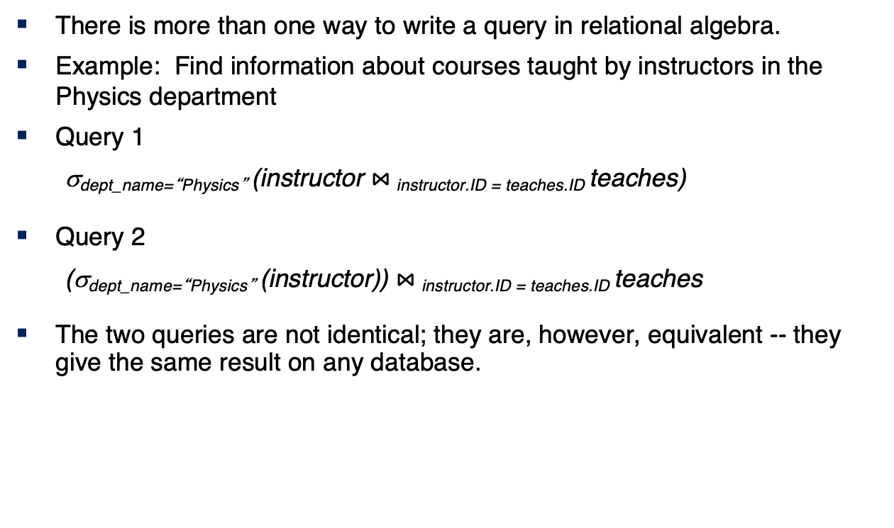
Equivalent Queries
There is more than one way to write a query in relational algebra.
Example: Find information about courses taught by instructors in the Physics department
Query 1
σ_{dept_name=“Physics”} (instructor $⋈_{ }$_{instructor.ID = teaches.ID} teaches)
Query 2
(σ_{dept_name=“Physics”} (instructor)) $⋈_{ }$_{instructor.ID = teaches.ID} teaches
The two queries are not identical; they are, however, equivalent -- they give the same result on any database.

Slide 30

Online Relational Algebra Tool
30 | W4111_02_F20: Introduction to Databases -- Lecture 3

Slide 31
Demos
Online relational tool https://dbis-uibk.github.io/relax/landing
31 | W4111_02_F20: Introduction to Databases – Lecture 2

Slide 32
SQL Continued
32 | W4111_02_F20: Introduction to Databases -- Lecture 4

Slide 33
Lecture Material – From Book Slides
33 | W4111_02_F20: Introduction to Databases -- Lecture 4

Slide 34
Data Definition Language
The SQL data-definition language (DDL) allows the specification of information about relations, including:
The schema for each relation.
The type of values associated with each attribute.
The Integrity constraints
The set of indices to be maintained for each relation.
Security and authorization information for each relation.
The physical storage structure of each relation on disk.

Slide 35
Create Table Construct
An SQL relation is defined using the create table command:
create table r
(A₁ D₁, A₂ D₂, ..., A_{n} D_{n}, (integrity-constraint₁), ..., (integrity-constraint_{k}))
r is the name of the relation
each A_{i} is an attribute name in the schema of relation r
D_{i} is the data type of values in the domain of attribute A_{i}
Example:
create table instructor ( ID char(5), name varchar(20), dept_name varchar(20), salary numeric(8,2))

Slide 36
Integrity Constraints in Create Table
Types of integrity constraints
primary key (A₁, ..., A_{n} )
foreign key (A_{m}, ..., A_{n} ) references r
not null
SQL prevents any update to the database that violates an integrity constraint.
Example:
create table instructor ( ID char(5), name varchar(20) not null, dept_name varchar(20), salary numeric(8,2), primary key (ID), foreign key (dept_name) references department

Slide 37
And a Few More Relation Definitions
create table student ( ID varchar(5), name varchar(20) not null, dept_name varchar(20), tot_cred numeric(3,0), primary key (ID),
foreign key (dept_name) references department);
create table takes ( ID varchar(5), course_id varchar(8), sec_id varchar(8), semester varchar(6), year numeric(4,0), grade varchar(2),
primary key (ID, course_id, sec_id, semester, year) ,
foreign key (ID) references student, foreign key (course_id, sec_id, semester, year) references section);

Slide 38
And more still
create table course ( course_id varchar(8), title varchar(50), dept_name varchar(20), credits numeric(2,0),
primary key (course_id),
foreign key (dept_name) references department);

Slide 39
Updates to tables
Insert
insert into instructor values ('10211', 'Smith', 'Biology', 66000);
Delete
Remove all tuples from the student relation
delete from student
Drop Table
drop table r
Alter
alter table r add A D
where A is the name of the attribute to be added to relation r and D is the domain of A.
All exiting tuples in the relation are assigned null as the value for the new attribute.
alter table r drop A
where A is the name of an attribute of relation r
Dropping of attributes not supported by many databases.

Slide 40
Basic Query Structure
A typical SQL query has the form: select A₁, A₂, ..., A_{n} from r₁, r₂, ..., r_{m} where P
A_{i} represents an attribute
R_{i} represents a relation
P is a predicate.
The result of an SQL query is a relation.
Notes:
2

Slide 41
The Rename Operation
The SQL allows renaming relations and attributes using the as clause:
old-name as new-name
Find the names of all instructors who have a higher salary than some instructor in 'Comp. Sci'.
select distinct T.name from instructor as T, instructor as S where T.salary > S.salary and S.dept_name = 'Comp. Sci.’
Keyword as is optional and may be omitted instructor as T ≡ instructor T
Notes:
9

Slide 42
Joined Relations
Join operations take two relations and return as a result another relation.
A join operation is a Cartesian product which requires that tuples in the two relations match (under some condition). It also specifies the attributes that are present in the result of the join
The join operations are typically used as subquery expressions in the from clause
Three types of joins:
Natural join
Inner join
Outer join

Slide 43
Natural Join in SQL
Natural join matches tuples with the same values for all common attributes, and retains only one copy of each common column.
List the names of instructors along with the course ID of the courses that they taught
select name, course_id from students, takes where student.ID = takes.ID;
Same query in SQL with “natural join” construct
select name, course_id from student natural join takes;
select name, course_id from students, takes
select name, course_id from students JOIN takes

Slide 44
R(a,b,c,d)
S(a,b,e,f)
Select * from R natural S
Select * from R join S where R.a=S.a and R.b=S.b
Select * from R JOIN S using(a)
Select * from R join S where R.a=S.a

Slide 45
Natural Join in SQL (Cont.)
The from clause can have multiple relations combined using natural join:
select A₁, A₂, … A_{n} from r₁ natural join r₂ natural join .. natural join r_{n} where P ;

Slide 46
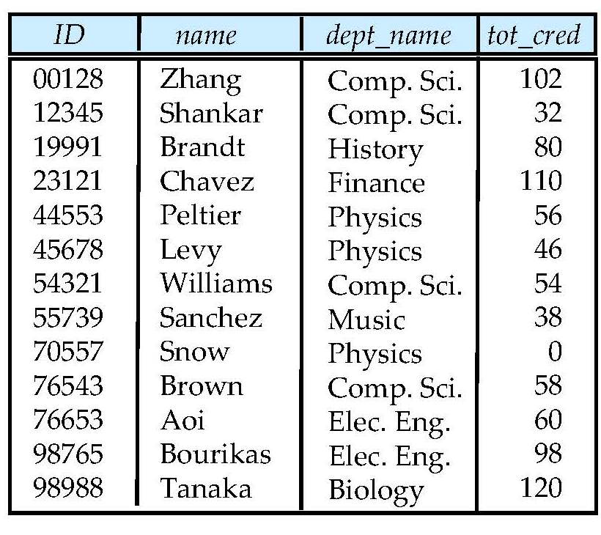
Student Relation

Slide 47
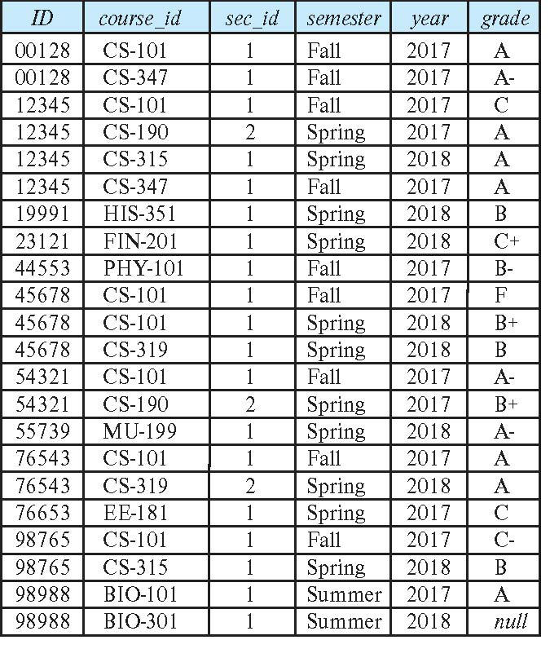
Takes Relation

Slide 48
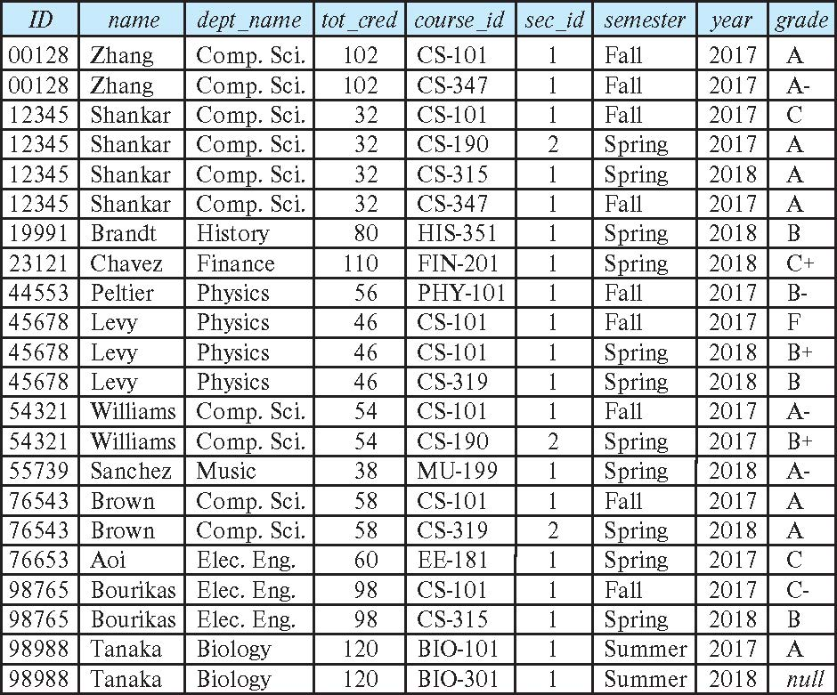
student natural join takes

Slide 49
Dangerous in Natural Join JOINS ARE DANGEROUS!!!!!
Beware of unrelated attributes with same name which get equated incorrectly
Example -- List the names of students instructors along with the titles of courses that they have taken
Correct version
select name, title from student natural join takes, course where takes.course_id = course.course_id;
Incorrect version
select name, title from student natural join takes natural join course;
This query omits all (student name, course title) pairs where the student takes a course in a department other than the student's own department.
The correct version (above), correctly outputs such pairs.

Slide 50
Natural Join with Using Clause
To avoid the danger of equating attributes erroneously, we can use the “using” construct that allows us to specify exactly which columns should be equated.
Query example
select name, title from (student natural join takes) join course using (course_id)

Slide 51
Join Condition
The on condition allows a general predicate over the relations being joined
This predicate is written like a where clause predicate except for the use of the keyword on
Query example
select * from student join takes on student_ID = takes_ID
The on condition above specifies that a tuple from student matches a tuple from takes if their ID values are equal.
Equivalent to:
select * from student , takes where student_ID = takes_ID

Slide 52
Join Condition (Cont.)
The on condition allows a general predicate over the relations being joined.
This predicate is written like a where clause predicate except for the use of the keyword on.
Query example
select * from student join takes on student_ID = takes_ID
The on condition above specifies that a tuple from student matches a tuple from takes if their ID values are equal.
Equivalent to:
select * from student , takes where student_ID = takes_ID

Slide 53
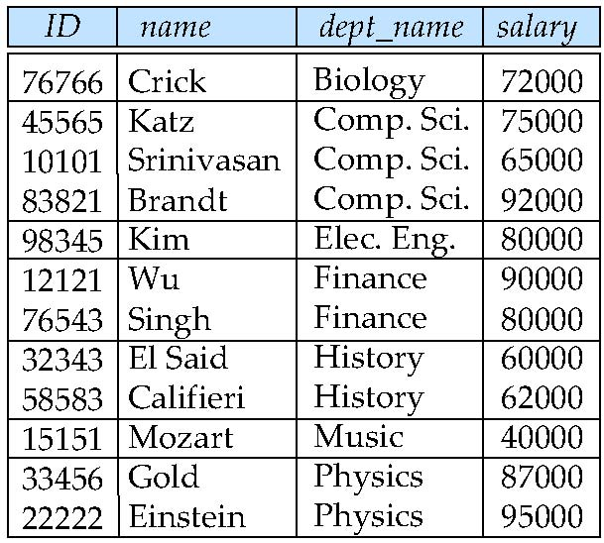
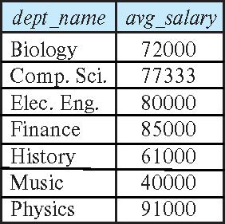
Aggregate Functions – Group By
Find the average salary of instructors in each department
select dept_name, avg (salary) as avg_salary from instructor group by dept_name;

Slide 54
Aggregation (Cont.)
Attributes in select clause outside of aggregate functions must appear in group by list
/* erroneous query */ select dept_name, ID, avg (salary) from instructor group by dept_name;

Slide 55
Aggregate Functions – Having Clause
Find the names and average salaries of all departments whose average salary is greater than 42000
Note: predicates in the having clause are applied after the formation of groups whereas predicates in the where clause are applied before forming groups
select dept_name, avg (salary) as avg_salary
from instructor
group by dept_name
having avg (salary) > 42000;

Slide 56
Nested Subqueries
SQL provides a mechanism for the nesting of subqueries. A subquery is a select-from-where expression that is nested within another query.
The nesting can be done in the following SQL query select A₁, A₂, ..., A_{n} from r₁, r₂, ..., r_{m} where P
as follows:
From clause: r_{i} can be replaced by any valid subquery
Where clause: P can be replaced with an expression of the form:
B <operation> (subquery)
B is an attribute and <operation> to be defined later.
Select clause:
A_{i} can be replaced be a subquery that generates a single value.
I do not consider this a subquery.
But, I guess that is just me.
I view this to be part of SQL’s realization of the algebra.
The formal model does not have the concept of queries inside a project or join condition.

Slide 57
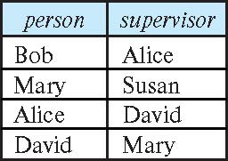
Self Join Example
Relation emp-super
Find the supervisor of “Bob”
Find the supervisor of the supervisor of “Bob”
Can you find ALL the supervisors (direct and indirect) of “Bob”?
Notes:
9

Slide 58
Set Membership

Slide 59
Set Membership
Find courses offered in Fall 2017 and in Spring 2018
Find courses offered in Fall 2017 but not in Spring 2018
select distinct course_id
from section
where semester = 'Fall' and year= 2017 and course_id in (select course_id
from section
where semester = 'Spring' and year= 2018);
select distinct course_id
from section
where semester = 'Fall' and year= 2017 and course_id not in (select course_id
from section
where semester = 'Spring' and year= 2018);

Slide 60
Set Membership (Cont.)
Name all instructors whose name is neither “Mozart” nor Einstein”
select distinct name
from instructor
where name not in ('Mozart', 'Einstein')
Find the total number of (distinct) students who have taken course sections taught by the instructor with ID 10101
Note: Above query can be written in a much simpler manner. The formulation above is simply to illustrate SQL features
select count (distinct ID)
from takes
where (course_id, sec_id, semester, year) in (select course_id, sec_id, semester, year
from teaches
where teaches.ID= 10101);

Slide 61
Set Comparison

Slide 62
Set Comparison – “some” Clause
Find names of instructors with salary greater than that of some (at least one) instructor in the Biology department.
Same query using > some clause
select distinct T.name
from instructor as T, instructor as S
where T.salary > S.salary and S.dept name = 'Biology';
select name
from instructor
where salary > some (select salary
from instructor
where dept name = 'Biology');

Slide 63
Definition of “some” Clause
F <comp> some r ⇔ ∃ t ∈ r such that (F <comp> t ) Where <comp> can be: <, ≤, >, =, ≠
0
(5 < some
5
) = true
(read: 5 < some tuple in the relation)
6
0
(5 < some
5
) = false
0
(5 = some
) = true
5
0
(5 ≠ some
5
) = true (since 0 ≠ 5)
(= some) ≡ in
However, (≠ some) ≡ not in

Slide 64
Set Comparison – “all” Clause
Find the names of all instructors whose salary is greater than the salary of all instructors in the Biology department.
select name
from instructor
where salary NOT = all (select salary
from instructor
where dept name = 'Biology');

Slide 65
Definition of “all” Clause
F <comp> all r ⇔ ∀ t ∈ r (F <comp> t)
0
(5 < all
5
) = false
6
6
(5 < all
) = true
10
4
(5 = all
) = false
5
4
(5 ≠ all
) = true (since 5 ≠ 4 and 5 ≠ 6)
6
(≠ all) ≡ not in
However, (= all) ≡ in

Slide 66
Test for Empty Relations
The exists construct returns the value true if the argument subquery is nonempty.
exists r ⇔ r ≠ Ø
not exists r ⇔ r = Ø

Slide 67
Use of “exists” Clause
Yet another way of specifying the query “Find all courses taught in both the Fall 2017 semester and in the Spring 2018 semester”
select course_id from section as S where semester = 'Fall' and year = 2017 and exists (select * from section as T where semester = 'Spring' and year= 2018 and S.course_id = T.course_id);
Correlation name – variable S in the outer query
Correlated subquery – the inner query

Slide 68
Use of “not exists” Clause
Find all students who have taken all courses offered in the Biology department.
Note that X – Y = Ø ⇔ X ⊆ Y
Note: Cannot write this query using = all and its variants
select distinct S.ID, S.name
from student as S
where not exists ( (select course_id
from course
where dept_name = 'Biology')
except
(select T.course_id
from takes as T
where S.ID = T.ID));
First nested query lists all courses offered in Biology
Second nested query lists all courses a particular student took

Slide 69
Test for Absence of Duplicate Tuples
The unique construct tests whether a subquery has any duplicate tuples in its result.
The unique construct evaluates to “true” if a given subquery contains no duplicates .
Find all courses that were offered at most once in 2017
select T.course_id from course as T where unique ( select R.course_id from section as R where T.course_id= R.course_id and R.year = 2017);

Slide 70
Subqueries in the From Clause

Slide 71
Subqueries in the Frmm Clause
SQL allows a subquery expression to be used in the from clause
Find the average instructors’ salaries of those departments where the average salary is greater than $42,000.”
select dept_name, avg_salary from ( select dept_name, avg (salary) as avg_salary from instructor group by dept_name) where avg_salary > 42000;
Note that we do not need to use the having clause
Another way to write above query
select dept_name, avg_salary from ( select dept_name, avg (salary) from instructor group by dept_name)
as dept_avg (dept_name, avg_salary)
where avg_salary > 42000;

Slide 72
With Clause
The with clause provides a way of defining a temporary relation whose definition is available only to the query in which the with clause occurs.
Find all departments with the maximum budget with max_budget (value) as (select max(budget) from department) select department.name from department, max_budget where department.budget = max_budget.value;

Slide 73
Complex Queries using With Clause
Find all departments where the total salary is greater than the average of the total salary at all departments
with dept _total (dept_name, value) as
(select dept_name, sum(salary)
from instructor
group by dept_name),
dept_total_avg(value) as
(select avg(value)
from dept_total)
select dept_name
from dept_total, dept_total_avg
where dept_total.value > dept_total_avg.value;

Slide 74
Scalar Subquery
Scalar subquery is one which is used where a single value is expected
List all departments along with the number of instructors in each department
select dept_name, ( select count(*) from instructor where department.dept_name = instructor.dept_name) as num_instructors from department;
Runtime error if subquery returns more than one result tuple

Slide 75
Modification of the Database
Deletion of tuples from a given relation.
Insertion of new tuples into a given relation
Updating of values in some tuples in a given relation

Slide 76
Deletion
Delete all instructors
delete from instructor
Delete all instructors from the Finance department delete from instructor where dept_name= 'Finance’;
Delete all tuples in the instructor relation for those instructors associated with a department located in the Watson building.
delete from instructor where dept name in (select dept name from department where building = 'Watson');

Slide 77
Deletion (Cont.)
Delete all instructors whose salary is less than the average salary of instructors
Problem: as we delete tuples from instructor, the average salary changes
Solution used in SQL:
First, compute avg (salary) and find all tuples to delete
Next, delete all tuples found above (without recomputing avg or retesting the tuples)
delete from instructor
where salary < (select avg (salary)
from instructor);

Slide 78
Insertion
Add a new tuple to course
insert into course values ('CS-437', 'Database Systems', 'Comp. Sci.', 4);
or equivalently
insert into course (course_id, title, dept_name, credits) values ('CS-437', 'Database Systems', 'Comp. Sci.', 4);
Add a new tuple to student with tot_creds set to null
insert into student values ('3003', 'Green', 'Finance', null);
insert into student(name, dept_name, id)
values(‘Green’, ‘Finance’, ‘3003’)

Slide 79
Insertion (Cont.)
Make each student in the Music department who has earned more than 144 credit hours an instructor in the Music department with a salary of $18,000.
insert into instructor select ID, name, dept_name, 18000 from student where dept_name = 'Music' and total_cred > 144;
The select from where statement is evaluated fully before any of its results are inserted into the relation.
Otherwise queries like
insert into table1 select * from table1
would cause problem

Slide 80
Updates
Give a 5% salary raise to all instructors
update instructor set salary = salary * 1.05
Give a 5% salary raise to those instructors who earn less than 70000 update instructor set salary = salary * 1.05 where salary < 70000;
Give a 5% salary raise to instructors whose salary is less than average
update instructor set salary = salary * 1.05 where salary < (select avg (salary) from instructor);

Slide 81
Updates (Cont.)
Increase salaries of instructors whose salary is over $100,000 by 3%, and all others by a 5%
Write two update statements:
update instructor set salary = salary * 1.03 where salary > 100000; update instructor set salary = salary * 1.05 where salary <= 100000;
The order is important
Can be done better using the case statement (next slide)

Slide 82
Case Statement for Conditional Updates
Same query as before but with case statement
update instructor set salary = case when salary <= 100000 then salary * 1.05 else salary * 1.03 end

Slide 83
Updates with Scalar Subqueries
Recompute and update tot_creds value for all students
update student S set tot_cred = (select sum(credits) from takes, course where takes.course_id = course.course_id and S.ID= takes.ID.and takes.grade <> 'F' and takes.grade is not null);
Sets tot_creds to null for students who have not taken any course
Instead of sum(credits), use:
case when sum(credits) is not null then sum(credits) else 0 end

Slide 84
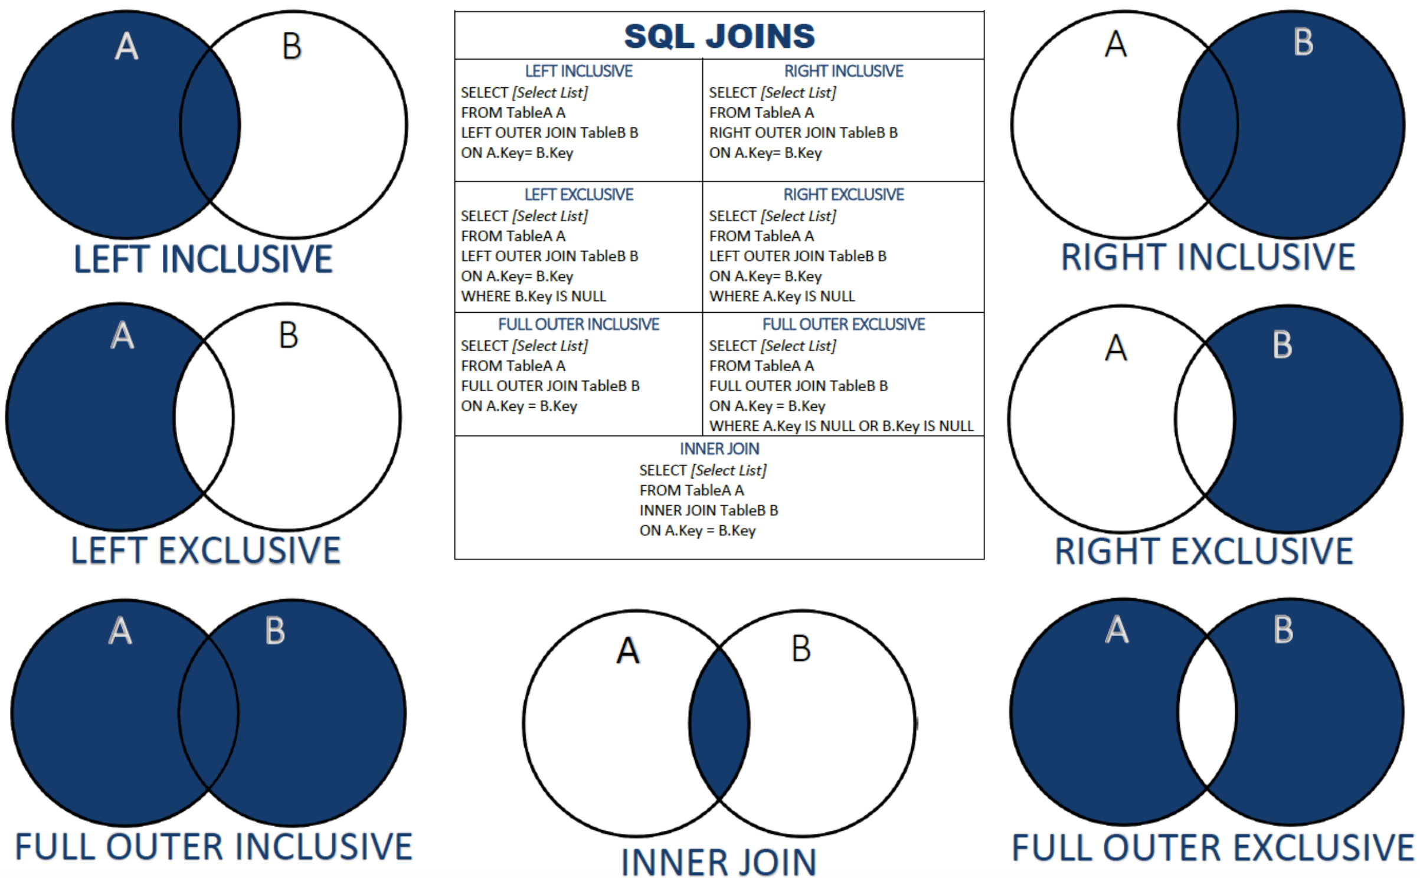
One Way to Think About JOINs
84 | W4111_02_F20: Introduction to Databases – Lecture 4

Slide 85
Entity-Relationship Model (Continued)
85 | W4111_02_F20: Introduction to Databases -- Lecture 4

Slide 86
Weak Entity Sets
Consider a section entity, which is uniquely identified by a course_id, semester, year, and sec_id.
Clearly, section entities are related to course entities. Suppose we create a relationship set sec_course between entity sets section and course.
Note that the information in sec_course is redundant, since section already has an attribute course_id, which identifies the course with which the section is related.
One option to deal with this redundancy is to get rid of the relationship sec_course; however, by doing so the relationship between section and course becomes implicit in an attribute, which is not desirable.

Slide 87
Weak Entity Sets (Cont.)
An alternative way to deal with this redundancy is to not store the attribute course_id in the section entity and to only store the remaining attributes section_id, year, and semester.
However, the entity set section then does not have enough attributes to identify a particular section entity uniquely
To deal with this problem, we treat the relationship sec_course as a special relationship that provides extra information, in this case, the course_id, required to identify section entities uniquely.
A weak entity set is one whose existence is dependent on another entity, called its identifying entity
Instead of associating a primary key with a weak entity, we use the identifying entity, along with extra attributes called discriminator to uniquely identify a weak entity.

Slide 88
Weak Entity Sets (Cont.)
An entity set that is not a weak entity set is termed a strong entity set.
Every weak entity must be associated with an identifying entity; that is, the weak entity set is said to be existence dependent on the identifying entity set.
The identifying entity set is said to own the weak entity set that it identifies.
The relationship associating the weak entity set with the identifying entity set is called the identifying relationship.
Note that the relational schema we eventually create from the entity set section does have the attribute course_id, for reasons that will become clear later, even though we have dropped the attribute course_id from the entity set section.

Slide 89
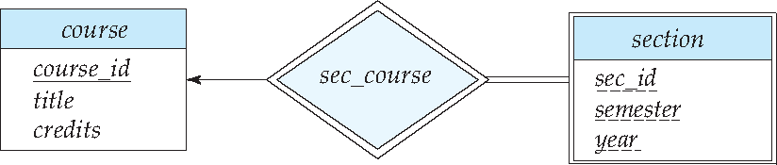
Expressing Weak Entity Sets
In E-R diagrams, a weak entity set is depicted via a double rectangle.
We underline the discriminator of a weak entity set with a dashed line.
The relationship set connecting the weak entity set to the identifying strong entity set is depicted by a double diamond.
Primary key for section – (course_id, sec_id, semester, year)

Slide 90
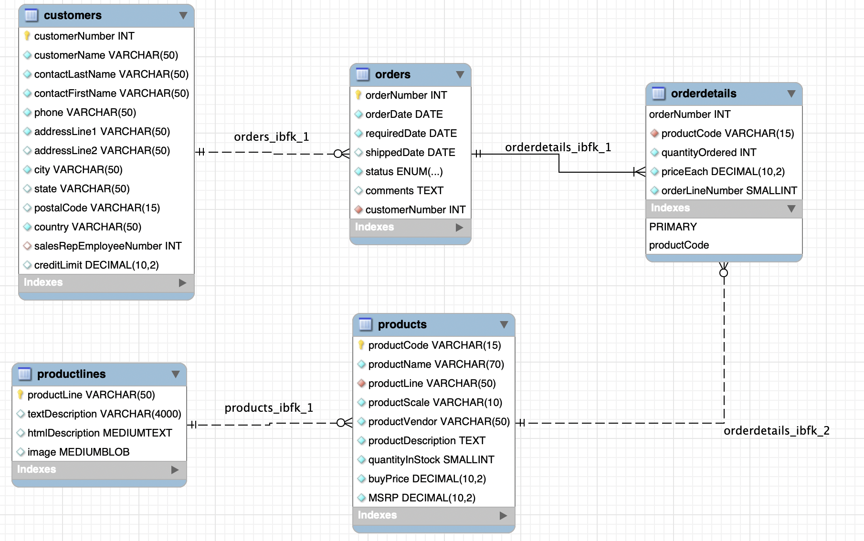
An Example – Classic Models
https://www.mysqltutorial.org/mysql-sample-database.aspx/
90 | W4111_02_F20: Introduction to Databases – Lecture 4

Slide 91
Customer ID: 201
OrderNo: 31
OrderedDate:504
ProductID | Quantity | Price | OrderID
111 | 2 | 2.10 | 31
101 | 11 | 1.30 | 31
333 | 102 | 47.5 | 31
Orders
LineItems

Slide 92
Let’s Do Some Worked Examples
92 | W4111_02_F20: Introduction to Databases -- Lecture 4

Slide 93
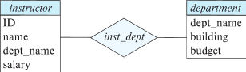
Redundant Attributes
Suppose we have entity sets:
instructor, with attributes: ID, name, dept_name, salary
department, with attributes: dept_name, building, budget
We model the fact that each instructor has an associated department using a relationship set inst_dept
The attribute dept_name in instructor replicates information present in the relationship and is therefore redundant
and needs to be removed.
BUT: when converting back to tables, in some cases the attribute gets reintroduced, as we will see later.

Slide 94
An Example – Redundant Attributes
Let’s see an example.
94 | W4111_02_F20: Introduction to Databases – Lecture 2

Slide 95
Design Alternatives
In designing a database schema, we must ensure that we avoid two major pitfalls:
Redundancy: a bad design may result in repeat information.
Redundant representation of information may lead to data inconsistency among the various copies of information
Incompleteness: a bad design may make certain aspects of the enterprise difficult or impossible to model.
Avoiding bad designs is not enough. There may be a large number of good designs from which we must choose.
Emphasis Added
Notes:
95

Slide 96
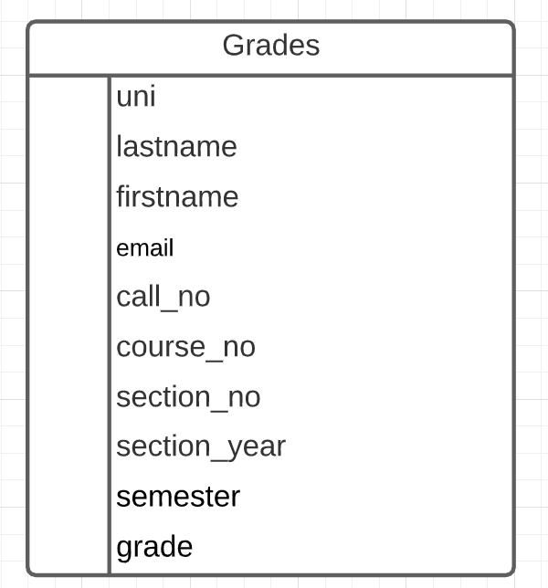
What is an Example?
Consider the Grades table/relation:
Uni identifies student.
lastname, firstname, email have obvious meaning.
call_no, course_no, section_no, semester, section_year, grade have the obvious meanings relative to Columbia course info.
Let’s focus on redundant information problems:
Inside the table:
(uni, lastname, firstname, email)
(call_no, course_no, section_no, section_year, semester)
Between tables: Presumable there are other tables with information on
Course descriptions and sections.
Course enrollments.
Additional student information.
This is easier if we make some data and show how we can “break it.”
96 | W4111_02_S20: Introduction to Databases -- Lecture 3,4

